Slide 1

Virtual Judge - 虚拟在线评测系统
HUST ACM/ICPC Team

Slide 2
Contents
Introduction
1
1
Function & Features
2
Architecture
3
Design & Implementation
4
Summary
5

Slide 3


Introduction: About the Team
提高0602班
主设计，主程序
徐涵
电信0602班
参与设计，文档
张琦
提高0601班
搜集信息，测试
李乐

Slide 4
Introduction: Background & Request
Run a contest
Online problem resource
Don't reinvent wheels
Lock it in a black box

Slide 5

Functions
http://122.205.9.240:8080/judge
Test
1
2
3
Exercises
Training
Contest
You can use it to exersise programming
Members are trained using this system
Weekly Contest

Slide 6
Features
Awesome backend
1
Many OJs supported
2
Source code share
3
Easy to use
4

Slide 7
Architecture
xOJ Client
Database
Web
Service

Slide 8
Implementation: xOJ Client
The HyperText Transferation Protocal
1
1
Net API in Java
2
The Apach HttpClient Library
3
Restful Web API
4

Slide 9
Implementation: xOJ Client
Grab Problems
1
1
User Login/Logout
2
Submit your answer!
3
Grab the result
4
Use Threads to avoid busy-waiting
5

Slide 10
Implementation: Database
Five tables
1
1
t_user t_problems t_sumission
2
t_contest t_cproblem
3
Use Hibernate to manipulate data
4

Slide 11
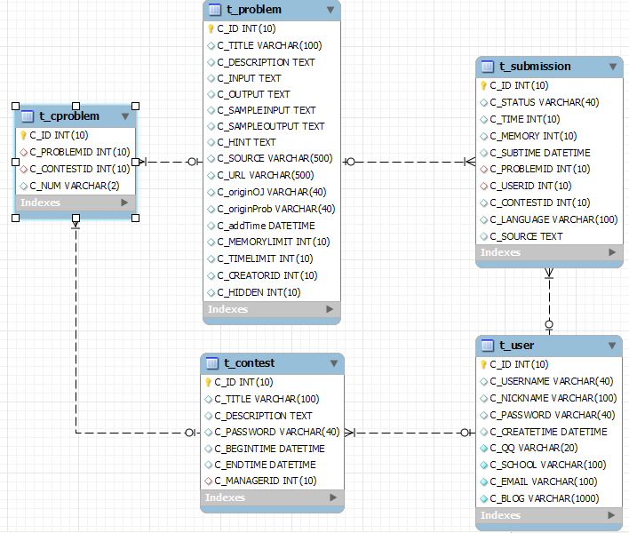
Database

Slide 12
Implementation: Web Service
UserAction.java
1
1
ProblemAction.java
2
ContestAction.java
ContestAction.java
3
Resource Oriented Web Service
4

Slide 13
Deployment
System Requirements
1
1
Server-side Softwares
2
The distribution package
3
Installation
4
How to Setup
5

Slide 14
Deployment
OS: Windows XP SP3
Softwares: MySQL 5.1, Tomcat 6.0
Steps:
1. copy judge.war to directory webapp/
2. run startup.bat
3. Edit webapp/judge/WEB-INF/db.properties:
Jdbc.username = username
Jdbc.password = password
change them to your own values
4. Import judge.sql to MySQL
5. Restart tomcat

Slide 15

Further Goals
More OJs to support
Test & Debug
Ajax Support
BBS
Source Management

Slide 16
Summary: Technologies
The Java Language
1
1
HTTP Client
2
Database & JDBC
3
J2EE: SSH
4
HTML & CSS
5

Slide 17

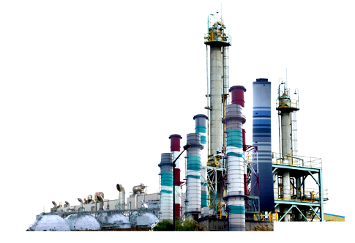

Thank you!

